Slide 1
Model Checking Behaviors of Software Product Lines
Using Featured Transition Systems (FTS)

Slide 2
Source Papers
A. Classen, P. Heymans, P.-Y. Schobbens, A. Legay, and J.-F. Raskin, “Model checking lots of systems: efficient verification of temporal properties in software product lines,” ICSE ’10.
A. Classen, P. Heymans, P.-Y. Schobbens, and A. Legay, “Symbolic model checking of software product lines,” ICSE ’11
M. Cordy, A. Classen et al. “Simulation-based Abstraction for Software Product Line Model Checking,” ICSE ‘12

Slide 3
Relations between The Papers
ICSE’ 10: Concept and Model Checking of Featured Transition Systems (LTL: Linear Temporal Logics)
ICSE’ 11: A faster LTL Solver
ICSE’ 12: Reduce Problem Space (States in FTS)

Slide 4
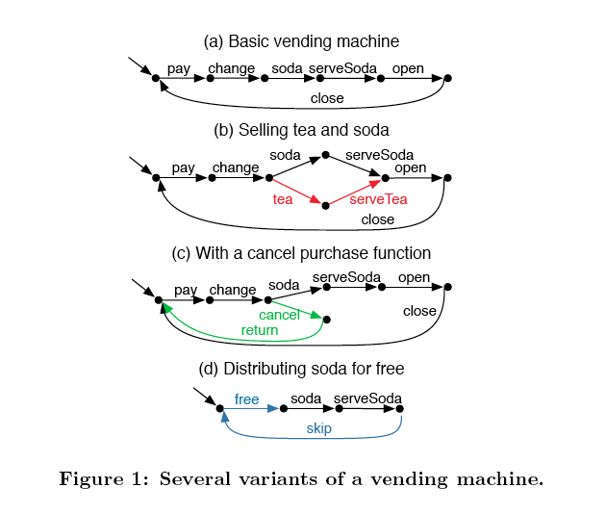
Transition System for Products

Slide 5
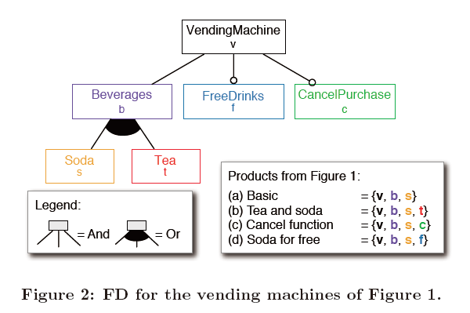
The Feature Model

Slide 6
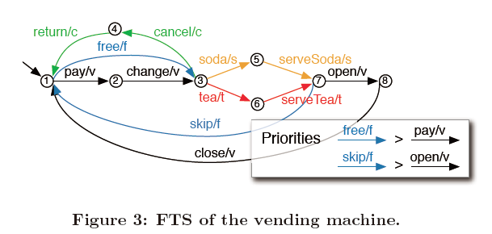
FM + TS = FTS
Priority: Child > Parent

Slide 7
Benefits of FTS
Without FTS
Check behaviors of products one by one
With FTS
Check as a whole (based on TS checking techniques, e.g. Linear Temporal Logics)

